Slide 1
Commands
Network Programming
Dr.Mohammed Abdalla Mahmoud Youssif
1

Slide 2
OUTLINE
Introduction
Basic network command and Network configuration commands
IPCONFIG
Ping
tracert
nslookup
pathping
netstat
2
Notes:
2

Slide 3
Introduction
IP address
An IP address is a unique network layer numbering system that end systems use in order to identify and communicate with each other.
It is a dotted decimal notation with four numbers ranging from 0 to 255 separated by periods.
The numbers currently used in IP addresses range from 1.0.0.0 to 255. 255. 255. 255, though some of these values are reserved for specific purposes.

Slide 4
Introduction
A Subnet
A subnet (short for "subnetwork") is an identifiably separate part of an organization's network.
Typically, a subnet may represent all the machines at one geographic location, in one building, or on the same local area network (LAN).
Having an organization's network divided into subnets allows it to be connected to the Internet with a single shared network address.

Slide 5
Introduction
Subnet
Without subnets, an organization could get multiple connections to the Internet, one for each of its physically separate subnetworks, but this would require an unnecessary use of the limited number of network numbers the Internet has to assign.
It would also require that Internet routing tables on gateways outside the organization would need to know about and have to manage routing that could and should be handled within an organization.

Slide 6
Introduction
A default gateway
is a node on a computer network that serves as an access device to another network.
The default gateway address is usually an interface belonging to the LAN’s border router
Routers
A router is a network device that forwards network traffic along optimized paths.
Router uses networks protocols (set of network rules, and algorithms) to connect different network segments.
A router allows users in a network to share a single connection to the Internet or a WAN.

Slide 7
Introduction
Workstations
This is a computer that is directly used by someone to do work (or have fun). A workstation often acts as a server when file or printer sharing is enabled. Workstations usually run Windows 95, 98, ME, NT Workstation, 2000 Professional, or XP, Mac OS, and rarely Linux (NOT Windows NT Server, Windows 2000 Server, Unix, or Novel).
Switches
a device that filters and forwards packets between LAN segments. Switches operate at the data link layer (layer 2) and sometimes the network layer (layer 3) of the OSI Reference Model and therefore support any packet protocol. LANs that use switches to join segments are called switched LANs or, in the case of Ethernet networks, switched Ethernet LANs

Slide 8
Introduction
Repeater
Functioning at Physical Layer. A repeater is an electronic device that receives a signal and retransmits it at a higher level and/or higher power, or onto the other side of an obstruction, so that the signal can cover longer distances.
Repeater have two ports ,so cannot be use to connect for more than two devices

Slide 9
Introduction
Hub
An Ethernet hub, active hub, network hub, repeater hub, hub or concentrator is a device for connecting multiple twisted pair or fiber optic Ethernet devices together and making them act as a single network segment
Hubs work at the physical layer (layer 1) of the OSI model.

Slide 10
Introduction
Bridge
A network bridge connects multiple network segments at the data link layer (Layer 2) of the OSI model
A bridge and switch are very much alike; a switch being a bridge with numerous ports. Switch or Layer 2 switch is often used interchangeably with bridge.
Bridges can analyze incoming data packets to determine if the bridge is able to send the given packet to another segment of the network.

Slide 11
Basic network command and Network configuration commands
This commands includes
• Configuring the Router commands
• General Commands to configure network
• Privileged Mode commands of a router
• Router Processes & Statistics
• IP Commands
• Other IP Commands e.g. show ip route etc.

Slide 12
IPCONFIG
ipconfig Is used to find out your current TCP/IP settings. With IPCONFIG you can find out your IP Address, find your Default Gateway and find your Subnet Mask. This is a very handy network tool for finding your local IP address.
ipconfig /all To display all your IP information for all adapters. With ipconfig /all you can also find out your DNS Server and MAC Address. This will show your full TCP/IP configuration for all adapters on your Windows machine. You can find out your own IP Address as well as your default gateway(router).
Notes:
.

Slide 13
IPCONFIG
ipconfig /displaydns This shows your current DNS Resolver Cache Logs. Hint.
The DNS translates Internet domain and host names to IP addresses. DNS automatically converts the names we type in our Web browser address bar to the IP addresses of Web servers hosting those sites.
DNS implements a distributed database to store this name and address information for all public hosts on the Internet. DNS assumes IP addresses do not change (are statically assigned rather than dynamically assigned).

Slide 14
Ping
PING (Packet INternet Groper) command is the best way to test connectivity between two nodes.
Whether it is Local Area Network (LAN) or Wide Area Network (WAN).
Ping use ICMP (Internet Control Message Protocol) to communicate to other devices. You can ping host name of ip address using below command.

Slide 15
Ping
1. Ping the host to see if its alive
ping google.com
2. Increase or Decrease the Time Interval Between Packets
Increase Ping Time Interval Example: Wait for 5 seconds before sending the next packet.
ping -i 5 google.com

Slide 16
Ping
Decrease Ping Time Interval Example: Wait 0.1 seconds before sending the next packet.
ping -i 3 google.com
3. Send N packets and stop
ping -c 4 google.com
4. Change Ping Packet Size
Example: Change the default packet size from 56 to 100.
ping -s 100 localhost

Slide 17
Ping
5. Timeout
The following example will ping for 5 seconds. i.e ping command will exit after 5 seconds irrespective of how many packets are sent or received.
ping -w 5 localhost
6. Specify path for ping to send the packet
You can also specify through which path the ping should send the packet to destination.
ping 192.168.3.33 192.168.7.1 192.168.4.45

Slide 18
tracert
tracert site.com With Trace route you can trace the path your packets take across the internet from you to your destination. Along the way you can determine the time from hop to hop. You can identify server problems and latency with this tool. It really helps see where the failure is between you and a destination.

Slide 19
nslookup
nslookup site.com nslookup xxx.xxx.xxx.xxx nslookup is a way to get the IP address for a domain name. You can also do a reverse lookup from Domain Name to IP Address. It can be a way to find out if your DNS is properly working or if the site is having problems. You can obtain an IP from a site and try to visit the IP directly, bypassing the Domain Name Servers that would usually resolve the Domain name to IP name.

Slide 20
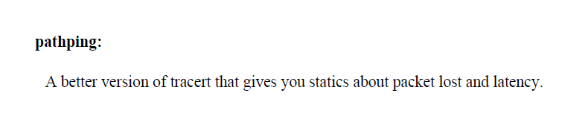
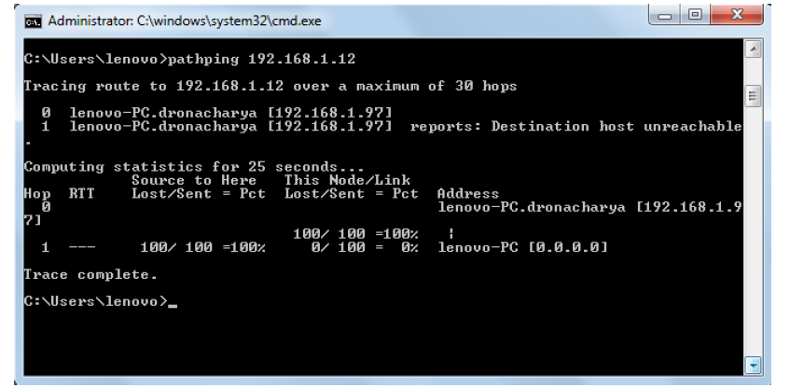
pathping

Slide 21
netstat
Netstat is an essential tool for network engineers, system administrators, and developers.
Troubleshooting network problems and having an overview of all the network activities and port availability are just some use cases of this tool.

Slide 22
netstat
netstat can be used to view your active network connections and TCP/IP connections.
You can determine what ports are open and being used, what programs are using your ports and what kind of TCP and UDP connections are present.
Looking in here for the first time may scare the hell out of you. netstat Switches netstat -a Displays all active TCP connections. And TCP / UDP ports. netstat -e Displays ethernet statistics. netstat -b Displays all active programs that are listening.

Slide 23
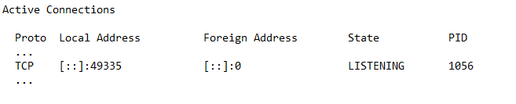
How to Kill process associated with Port in windows ?
C:\>netstat -ano

Slide 24

How to Kill process associated with Port in windows ?
C:\>tasklist /fi "pid eq 1056”

Slide 25
How to Kill process associated with Port in windows ?
taskkill /PID 827

Slide 26
Questions ?
26
Notes:
26

